Slide 1
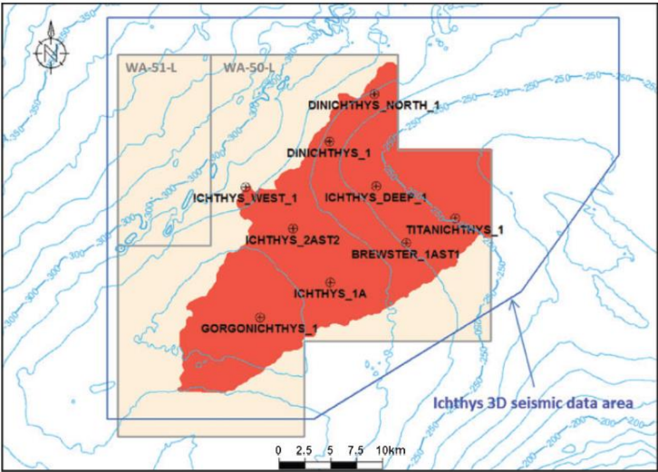
WELL LOGGING CASE STUDY – GROUP 5
Well name :-
Ichthys Deep 1
Submitted By:
Anwesha Kodal (22MC0020)
Navaneeth Babu M. (22MC0058)
Pranav Chandrode (20JE0702)
Shreya hembrom (22MC0088)
Submitted To :-
Prof. Partha P. Mondal

Slide 2
CASE STUDY OBJECTIVES
GAMMA RAY TOOL INSTRUMENTATION
QUALITY CONTROL OF LOG DATA
TOTAL POROSITY CALCULATION FROM DENSITY AND NEUTRON COMBINATION
VELOCITY-DEPTH PROFILE
CALCULATION OF WATER SATURATION (ARCHIES LAW)
TOTAL POROSITY, WATER SATURATION AND V_{SH} OF THE RESERVOIR ZONE WITH STANDARD DEVIATION

Slide 3
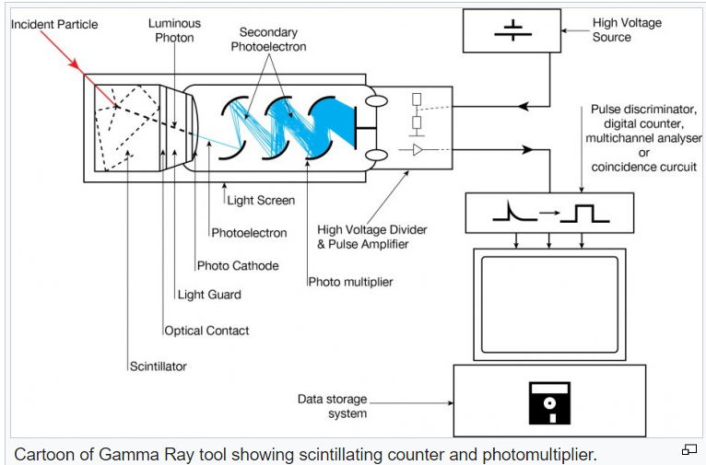
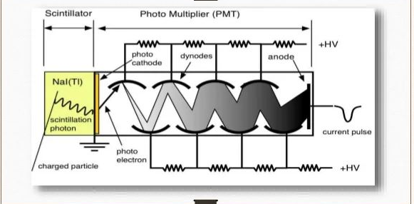
Part 1: Gamma Ray Tool Instrumentation

Slide 4
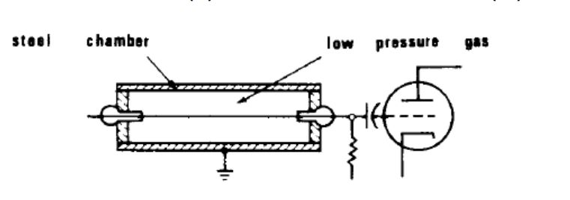
WORKING:
The Gamma-Ray Spectroscopy Tool (GST'M) is a downhole NaI(Tl) based nuclear gamma ray spectrometer system, which detects gamma rays produced from reactions induced by 14-MeV neutrons irradiating the formation.
The Total Gamma Ray tool records total gamma ray detections to produce a Gamma Ray log; the tool is made up of a scintillation counter and a photomultiplier tube. The scintillation counter is typically a crystal of sodium iodide (NaI) which produces a flash of light when bombarded with Gamma rays.
The flash of light is detected by the photomultiplier tube and converted into an electric signal that is then counted going down-hole
. The count is then recorded in American Petroleum Institute (API) units, which is defined as “The gamma ray API unit is defined as 1/200 of the difference between the count rate recorded by a logging tool in the middle of the radioactive bed and that recorded in the middle of the nonradioactive bed” recorded within the calibration pit.

Slide 5
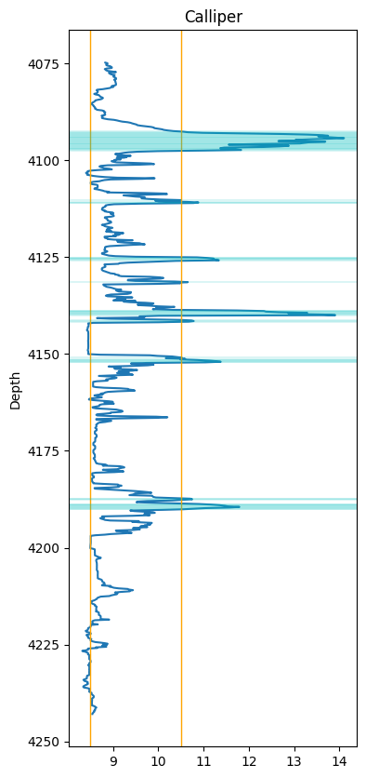
Part 2: Identifying bad borehole condition
Brewster Member zone for well-ID1 is
4074.5m to 4242.9m
. Bit size over the long interval= 8.5’’
A major caving in borehole happens at a range of 4090m to 4098m
Deep but thin caving at a depth around 4140m
A small but visible caving is observed at a depth of 4188m
Condition for borehole flag:
(Calliper – Bit size) >= 2’’

Slide 6
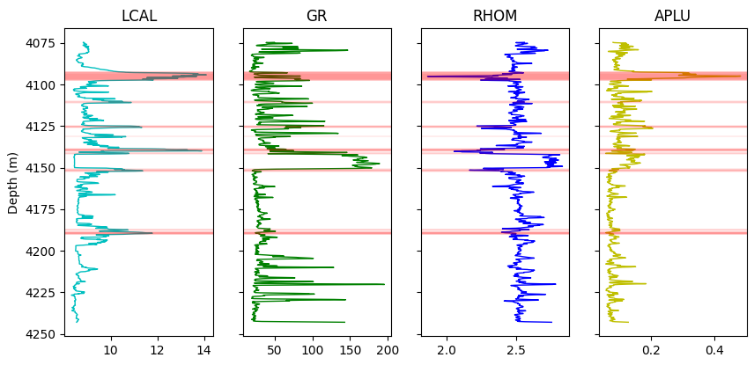
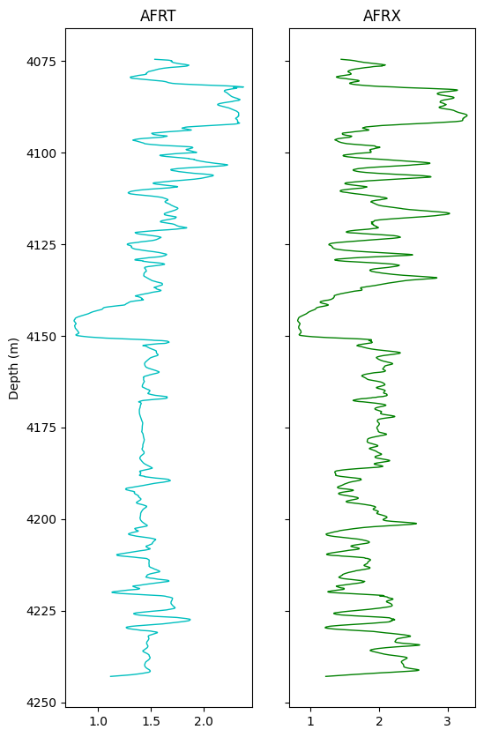
Bad borehole condition and its effect on basic logs

Slide 7
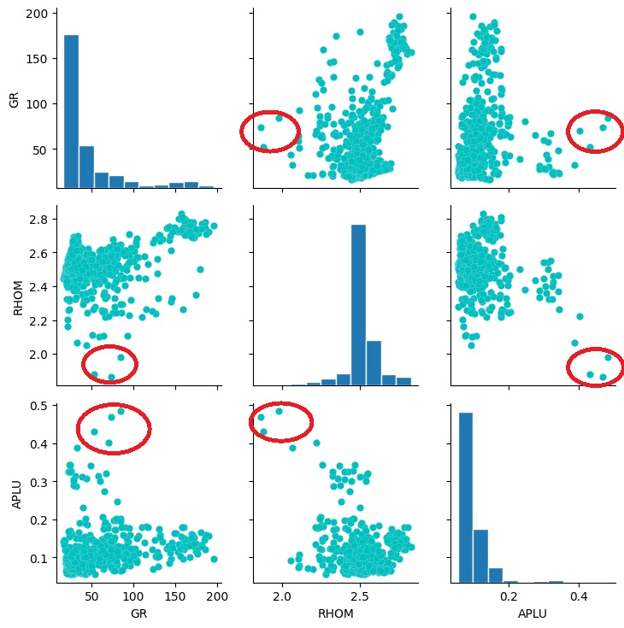
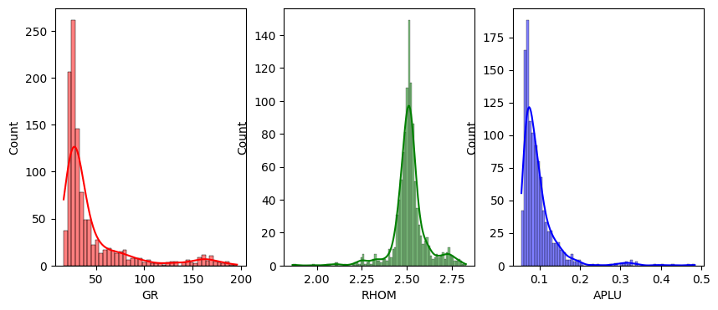
Histogram of some basic logs and their cross plots for well-ID1

Slide 8

Part 3 : Total Porosity From The Density And Neutron Combination
DENSITY POROSITY (DPHI) is given by
$$φ_{D}= \frac{ρ_{ma}− ρ_{b}}{ρ_{ma}− ρ_{fl}}$$
$ρ_{ma}$= the density of the rock matrix here, ${ ρ}_{ma}$= 2.65 gm/cc for sandstone
$ρ_{b}$ = the bulk density of formation $ρ_{b}$ = [from log]
$ρ_{fl}$= the density of pore fluid $ρ_{fl}$=1.1 gm/cc
$φ_{D}$ = density porosity
NEUTRON POROSITY (NPHI) is obtained directly from log data
Then total porosity from density – neutron combination is obtained by ,
(i) For gas bearing formation,
$φ_{N−D}= \sqrt{\frac{{φ_{N}}^{2}+{φ_{D}}^{2}}{2}}$
(ii) For oil or brine formation
$φ_{N−D}=$ $\frac{φ_{N}+φ_{D}}{2}$
where ,
$φ_{N}$ = Neutron porosity
$φ_{D}$ = Density Porosity

Slide 9
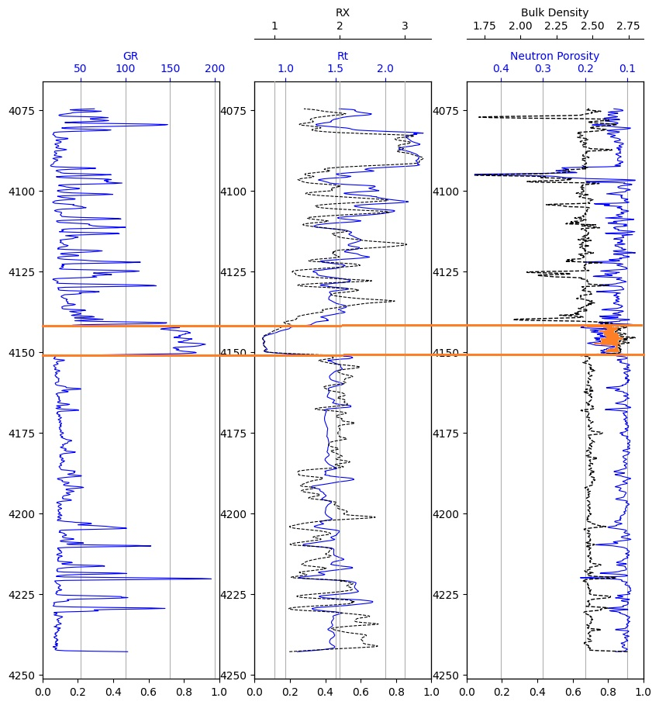
∅ 𝑁𝑐𝑜𝑟𝑟 = ∅ 𝑁 + ∅ 𝑀𝑐𝑜𝑟r
For sandstone , ∅ 𝑀𝑐𝑜𝑟r= +4
Gas
Neutron tool measures the HI of a formation. So NPHI of hydrocarbon gas is less than oil, water.
Bulk density is less for a porous formation filled with gas.
At a depth of 4142m to 4150m the curve for NPHI and bulk density intersect each other.
Sandstone zones bearing oil or gas have high resistivity. Where as the at the depth range 4142m to 4150m resistivity very low.
Gas

Slide 10
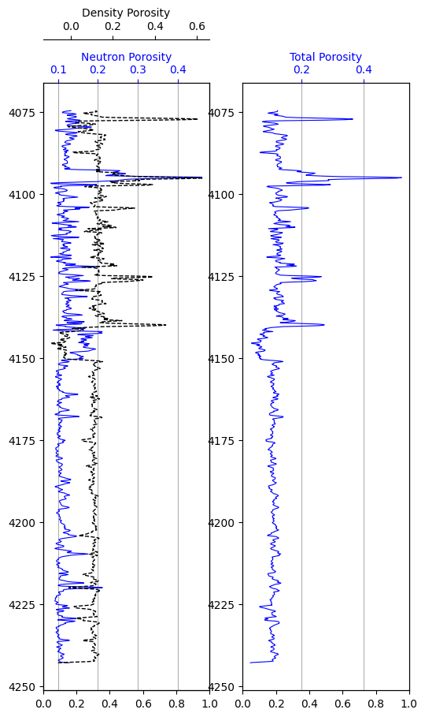
Overlay Plot of density porosity and neutron porosity and the total porosity
Highest porosity is observed around the zone 4090 m to 4100 m .
But the spike that is observed is due to the effect of bad borehole condition which is observed from caliper and bit size.

Slide 11
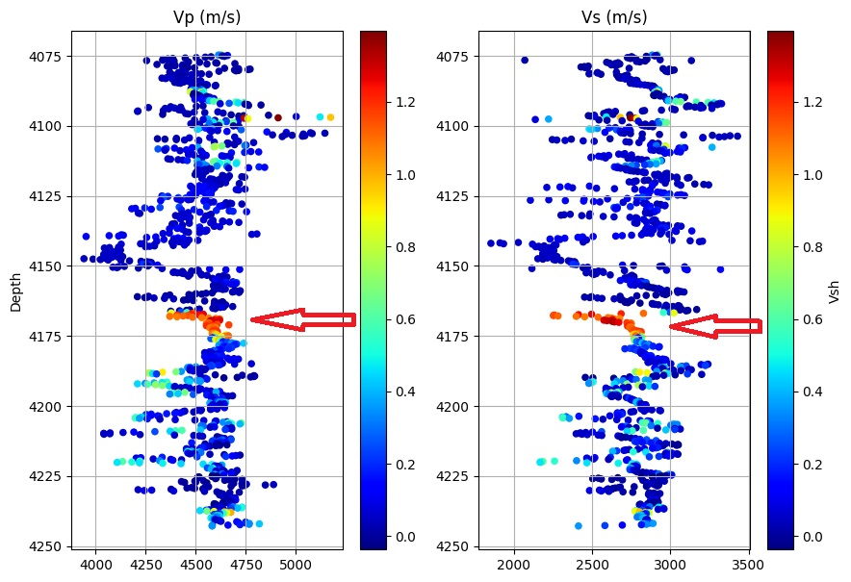
Part 4: Velocity depth profile colour coded with Volume of shale
Compressional sonic:
Vp=(304800/DT) m/s
Shear sonic:
Vs=(304800/DTS) m/s
Sonic wave travels faster in solid medium rather than fluid.
Zone with less porosity will have the highest Vp and Vs value. V shale is low.
Zone with high porosity will have less Vp and Vs value. V shale is high.

Slide 12
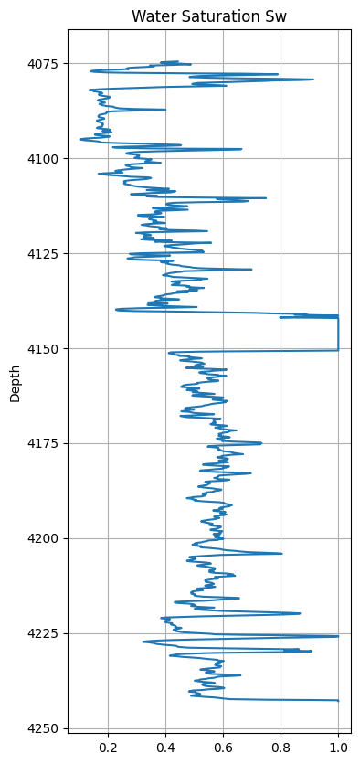
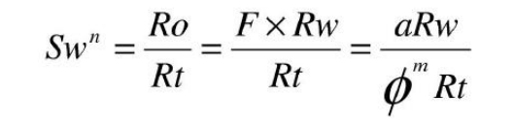
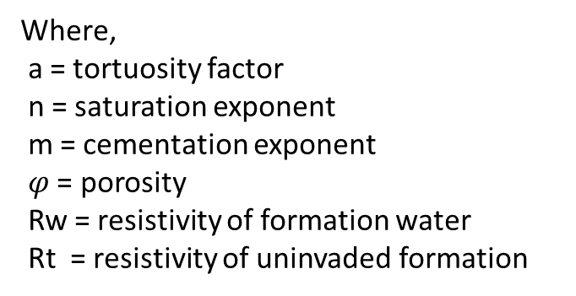
Part 5 : Water Saturation And Reservoir Flag
ARCHIE’S FORMULA
Where,
a = tortuosity factor
n = saturation exponent
m = cementation exponent
$φ$ = porosity
Rw = resistivity of formation water
Rt = resistivity of uninvaded formation

Slide 13
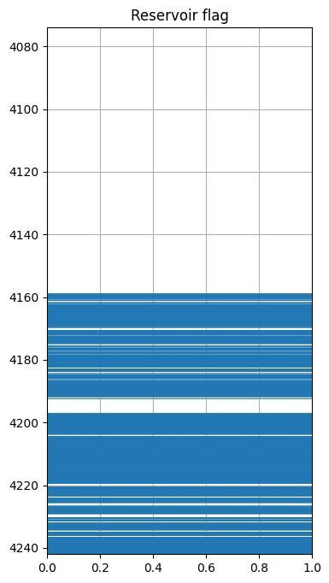

Reservoir flag is generated where volume of shale, Vsh <= 0.4 and Sw <= 0.7.
It is observed that the reservoir zone is between a depth of 4160 to 4190 m and between 4195 to 4242 m

Slide 14
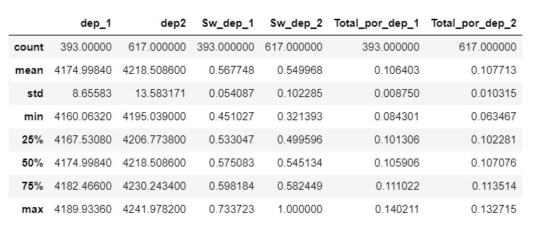
Part 6 : Total Porosity , Water Saturation And Volume Of Shale Of The Reservoir Zone Along With Standard Deviation
Reservoir zones is identified between 4160 to 4190 m and between 4195 to 4242 m .
The values of total porosity, water saturation, and volume of shale for this zone is reported along with their mean value and standard deviation.
Total Porosity and water saturation of the reservoir zone

Slide 15
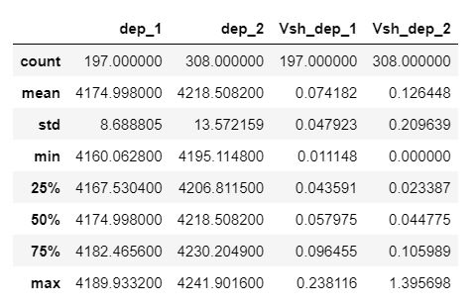
Volume of shale of the reservoir zone

Slide 16
